Slide 1
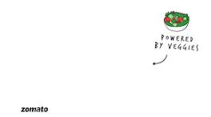

Weekly Milestone-1
To increase the number of customer text reviews
for the Food Delivery vertical
BY
DEEPAK SVG
Estimated Time to read -6-7 mins

Slide 2





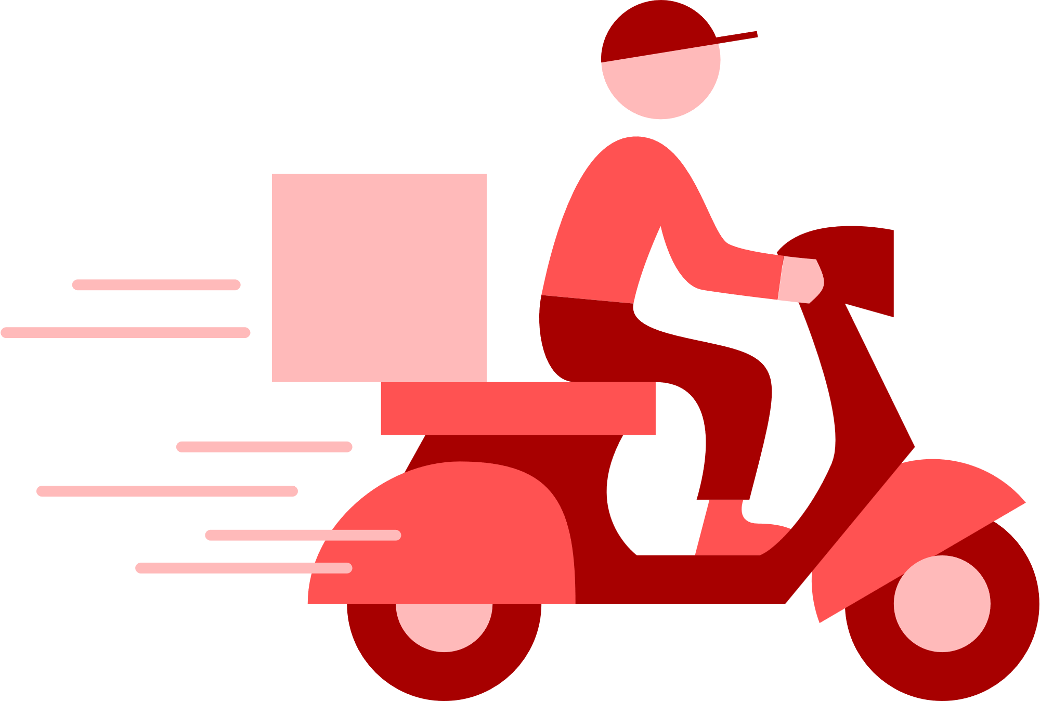









Understanding the Food Delivery Space in India
Market LandScope Over View
Insights into the factors leading the delivery space in India
INSPIRED BY
MARKET SIZE
COMPETITOR LANDSCOPE
REGULATIONS
ECOSYSTEM ACTORS
The Online Food Delivery space in India is projected to reach a revenue of US$43.78bn in 2024.
An annual growth rate (CAGR 2024-2029) of 15.98%.
The growth will result in a projected market volume of US$91.88bn by 2029
Major players in the Indian market include Swiggy, Zomato, Uber Eats (before its acquisition by Zomato) and Food Panda.
Key differentiators among competitors include delivery speed, variety of restaurants, customer service and demand for healthy and organic food .
Food preferences in different regions
Compliance with FSSAI (Food Safety and Standards Authority of India) regulations
Data privacy laws impacting customer data handling and review management.
Focus on ensuring fair business practices
Key players in eco systems are Restaurants, delivery partners, customers, and technology providers
Also driven by factors like the rise of middle class, internet and smart phones, last mile survey for delivery, digital services

Slide 3


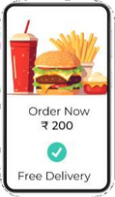
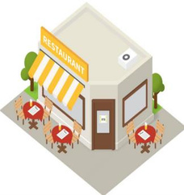

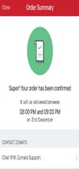
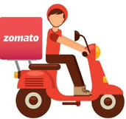
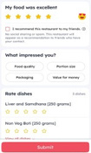





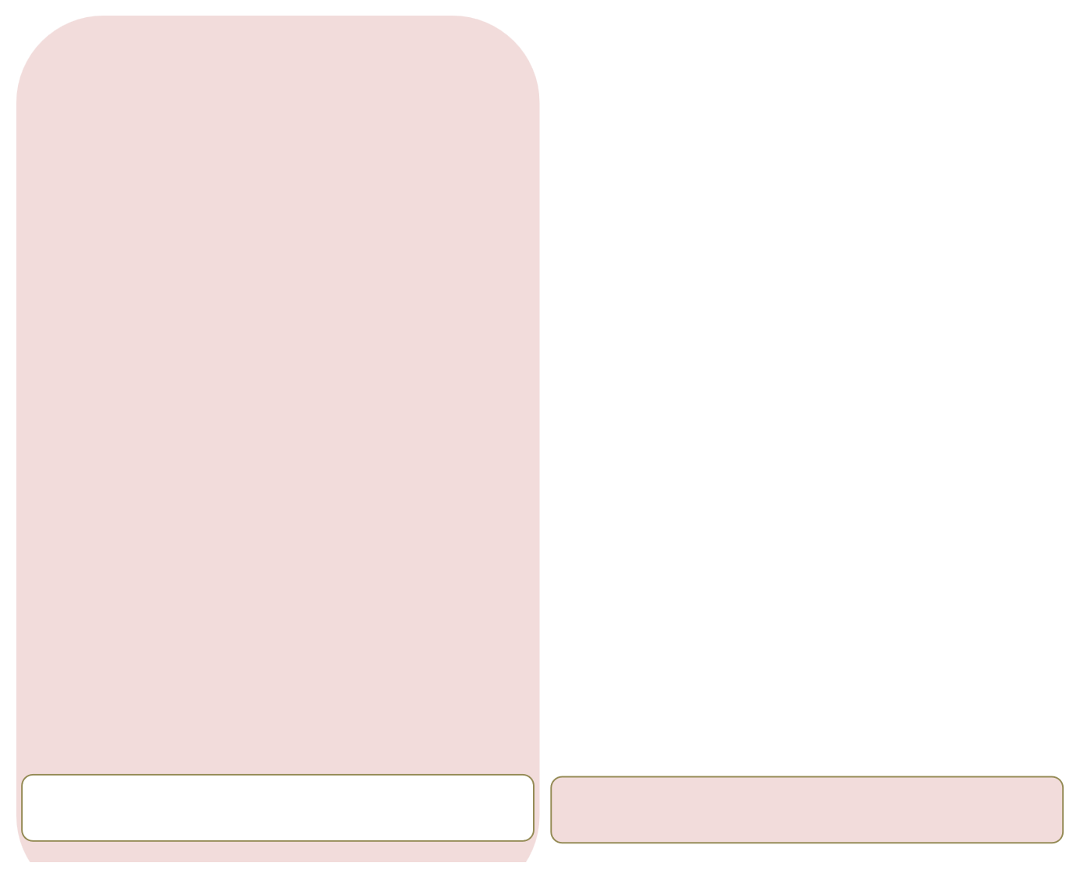



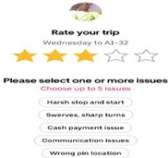
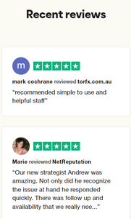
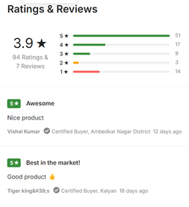
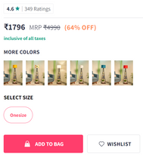

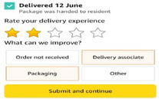
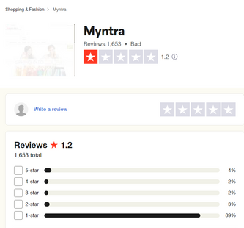
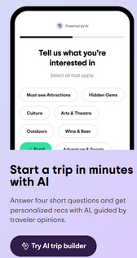
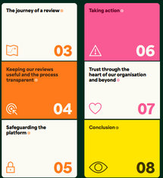
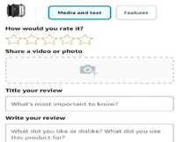
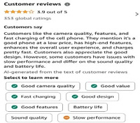
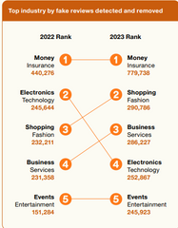
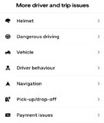
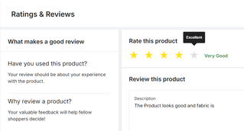
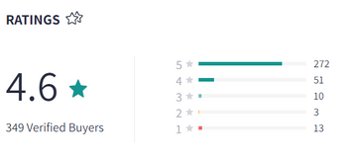
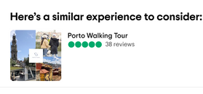
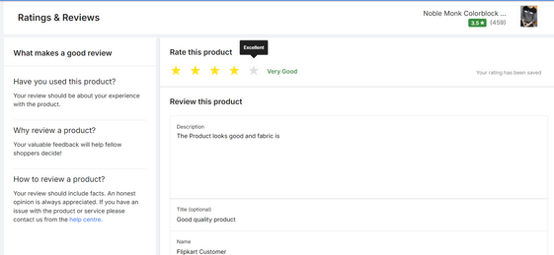
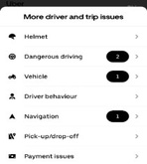
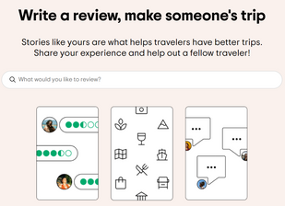
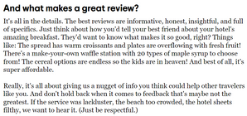
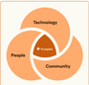
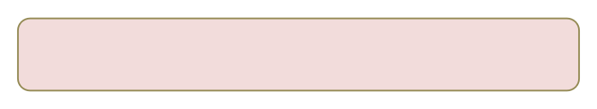
Customer Journey in Food Delivery Space
Rating & Reviews of Ecommerce Products
• • •
Salient Features:
Salient Features:
• •
Salient Features:
Salient Features:
Along with rating on delivery experience, detailed feedback on how it can be improved can be captured Feature-wise review of a product is available. Feature list is pre-populated based on product Option to give separate feedback to the seller
• •
Myntra offers an express delivery service for products marked with an "M-express tag" on the listing page
Myntra has a dedicated customer connect team that is available 24/7 to answer queries
Tripadvisor's platform aggregates reviews and opinions from members about destinations, accommodations, restaurants, and activities
ripadvisor is available in 43 markets and 22 languages
• •
Option to rate individual items in the order Option to rate delivery partner along with the restaurant and detailed text review option
What stood out:
What stood out:
What stood out:
What stood out:
•
AI generated summary of reviews + Video feedback option
AI-powered shopping experiences, virtual try-ons, and vernacular search.
•
Providing travel guidance to help people plan and enjoy their trips
•
Automated fraud detection software screens every review for
authenticity, to prevent unfair practices
•

Slide 4

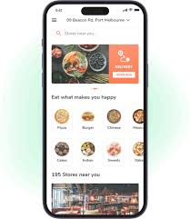


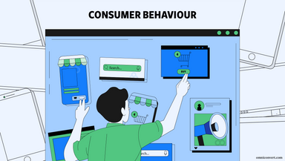





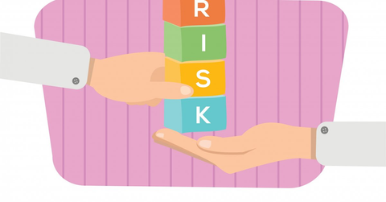
Why reviews matter for the business in the case of Zomato
Build Trust-Reviews from independent sources act as social proof, making customers more likely to trust a business.
Influence purchase decisions- Positive reviews can persuade customers to choose a business, which can boost sales
Enhance online reputation-Positive reviews can help a business establish a positive online reputation.
Provide insight for improvement-Reviews can help businesses identify areas for improvement and optimize their processes and customer experience
Help reduce risk-Reviews can help consumers understand if a restaurant
is safe to visit, and if the price is reasonable
Drive conversion -Reviews are the main driver of conversion on
Zomato,as customers look for information about a restaurant's
taste, quality, service, and price.

